Slide 1
Gillespie Algorithm
Notes:
The gillespie algorithm is the original ‘stochastic modeling’ method. It employs random numbers to simulate individual reaction events and is thus a chemically exact method of simulating the dynamics of a biochemical system.

Slide 2
The basic idea
There is a time series of events happening within a cell. Each event corresponds to some Reaction that occurred
cell1
Time
An Enzyme and a substrate formed a complex
An ES Complex made a product
An ES Complex dissociated
Notes:
A gillespie model begins with an enumeration of the reactions that can occur and an initial concentration of each species present in the system. Though typically the number of molecules you simulate is far fewer than the number in a cell, you can think of this as the simulation of the molecular history of one cell. It will simulate a random series of reactions just as they might occur in reality. For example, suppose we were modeling the michaelis-menton kinetics of an enzyme binding to a substrate and converting it to a product. Using gillespie, we would simulate individual random reaction events. For this, it employs two random numbers. One number chooses the time of the next event, and the other chooses the next reaction. The history of events occuring in this theoretical cell is then recorded.

Slide 3
The basic idea
Different random events are occurring within different cells
cell1
cell2
cell3
Time
Notes:
Typically you simulate many of these traces. Since this is all based on random choices of events, every trace will come out differently. However, if we do enough of these trace simulations, patterns will emerge in the data. In the limiting case of many molecules (like thousands) the results of the stochastic simulation will often approximate the results of a differential equation model. In other cases, they capture behavior that is lost in the less granular simulation.

Slide 4
The Gillespie Algorithm (stochastic modeling)
Write out all the possible elemental reactions that can happen
Each reaction has a probability associated with it, and the choice of next event is weighted by it
Choose 2 random numbers
The first # is to randomly pick the next reaction that will occur (a weighted choice based on the individual rates)
The second # is to pick when the next reaction will occur
Adjust all the concentrations of the individual components to account for whatever reaction got chosen
Iterate that to create a timeline for single chain of random events until some preset length of time has elapsed
Iterate that from the starting conditions many times
With a large list of chains, can combine the resulting states of the system
For many models, the result will be the same as an ODE model, but get additional information about the heterogeneity in the system, and a more precise model
Notes:
The first step in implementing Gillespie is to write out all the possible elemental reactions that can happen. Each reaction has a probability associated with it, and the choice of next event is weighted by it
After this initial setup that is specific to your system, you run the simulation. For each reaction in the trace, it will choose 2 random numbers. The first # is to randomly pick the next reaction that will occur. This choice is random, but it is weighted based on the individual rates of all reactions in the system. The second # is used to pick when the next reaction will occur.
After it has chosen its reaction, the algorithm adjusts all the concentrations of the individual components to account for whatever reaction took place. This process of reaction choosing and updating is iterated to create a timeline for a single chain of random events until some preset length of time has elapsed
Typically you run this simulation from the starting conditions many times. With a large list of trace data, you can combine the data in various ways to represent the scope of behaviors expected for the system.
For many models, the result will be the same as an ODE model, but you get additional information about the heterogeneity in the system, and a more precise model. In other cases, you may notice effects in the stochastic model that are not apparent in the diff eq model, and are manifested in the real system.

Slide 5
How to set up a stochastic simulation
Write out chemical reactions describing the system in its most granular form
For reversible reactions, the forward and reverse reactions are two distinct Reactions
E
+
S
ES
ES
E
+
S
ES
E
+
P
Notes:
Let’s try the example of Michaelis-Menton kinetics. The first step is to write out all the elemental equations. For reversible reactions, the forward and reverse reactions are two distinct reactions. So, we’d have an E+S to ES step, its reverse reaction, and then ES to E + P. You could also of course expand this into more intermediate states. For example, you could include steps of ES going to EP prior to its dissociation. If the reaction isn’t heavily exothermic, then you may also wish to capture the reverse reaction of E + P going to EP. Suffice it to say, the first step is to write out the reactions.

Slide 6
Identify all the Species
E
+
S
ES
ES
E
+
S
ES
E
+
P
In this case there are 4 Species
Notes:
The next step is to identify all your distinct species. Some of these, like E, S, and P are single molecules, while other species like ES will be complexes. *click* So, in this case there are 4 distinct species whose concentrations we need to follow.

Slide 7
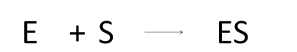
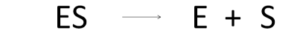
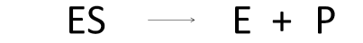
Write out the update matrix
E--; S--; ES++;
ES--; E++; S++;
ES--; E++; P++;
 | E | S | ES | P
rxn 1 | -1 | -1 | 1 | 0
rxn 2 | 1 | 1 | -1 | 0
rxn 3 | 1 | 0 | -1 | 1
Notes:
Next we must describe how to update the counts of the various species if a reaction occurs. If one of the enzymes and one of the substrates bind to one another and form an ES complex as shown in the first equation, then the total number of E will decrease by 1, S will decrease by 1, and ES will go up by one. This is analogous to the stoichiometry matrix we saw in flux balance analysis. *click* We already identified that in total there are 4 distinct species in our system, so there are 4 columns in our matrix and 3 reactions, so 3 rows. That isn’t a critical point to understand in terms of how the algorithm works, but I point it out to show the relatedness of the two methods in this regard.

Slide 8
Write out the rate expressions
k₁*E*S;
k₂*ES;
k₃*ES;
Notes:
The last thing we need are rate expressions. More accurately, they are equations that describe the probability that this reaction will occur. Fortunately, they look the same as elemental rate equations. So, it is just a rate constant multiplied by the number of each reactant, such as K1 times E times S for our first reaction.

Slide 9
Write out the rate expressions
E: 25
S: 583
ES: 5
P: 13
Time: 0 msec
Endtime: 10 msec
Notes:
Let’s describe what happens during this simulation. I’ve made up some *click* initial values for each species. We have 25 E’s, 583 S’s, 5 ES’s, and 13 P’s. We could have made these values any integer value. They represent the number of individual molecules or complexes in the system. *click* We also have an initial time, let’s say 0 milliseconds. We have also chosen an end time for the simulation at 10 milliseconds.

Slide 10
Choosing the Reaction.
E: 25
S: 583
ES: 5
P: 13
Time: 0 msec
Endtime: 10 msec
k₁*E*S;
k₂*ES;
k₃*ES;
Notes:
I pick two random numbers between zero and one, and I’m going to use those to choose the time of the next reaction and what reaction occurs. I use *click* these equations to weigh my decision about which reaction goes next. I calculate each one based on the current count of each species, then pick one randomly based on my random number weighted by these probabilities. Let’s say I chose *click* reaction 2. If this reaction occurs, then I need to examine my update matrix to see what happens to the species.

Slide 11
Updating Values
E: 25
S: 583
ES: 5
P: 13
Time: 0 msec
Endtime: 10 msec
E--; S--; ES++;
ES--; E++; S++;
ES--; E++; P++;
Notes:
For reaction two, ES decrements, and E and S go up one. So, my new values are

Slide 12
Updating Values
E: 26
S: 584
ES: 4
P: 13
Time: 0 msec
Endtime: 10 msec
E--; S--; ES++;
ES--; E++; S++;
ES--; E++; P++;
Notes:
my new values are 26 for E, 584 for S, and 4 for ES. I’ll also now update my time to a randomly chosen next value, say …

Slide 13
Updating Values
E: 26
S: 584
ES: 4
P: 13
Time: 4 msec
Endtime: 10 msec
E--; S--; ES++;
ES--; E++; S++;
ES--; E++; P++;
Notes:
4 msec. In the next step, I do it all again, so let’s say it chooses to do

Slide 14
Next Cycle
E: 26
S: 584
ES: 4
P: 13
Time: 4 msec
Endtime: 10 msec
Notes:
an * E + S over to ES reaction. Then I update

Slide 15
Next Cycle
E: 25
S: 583
ES: 5
P: 13
Time: 6 msec
Endtime: 10 msec
Notes:
my values as –E, -S, +ES, and perhaps the next time was 2 milliseconds, so now we are at 6 msec.

Slide 16
Next Cycle
E: 26
S: 584
ES: 4
P: 13
Time: 9 msec
Endtime: 10 msec
Notes:
Then perhaps it does another dissociation of ES complex, and that gets us to 9 msec

Slide 17
Next Cycle
E: 27
S: 584
ES: 3
P: 14
Time: 11 msec
Endtime: 10 msec
Notes:
Then it does an ES over to E plus P step, and we exceed 10 msec, so the algorithm stops. In practice, we’d set a smaller time interval such this ran many thousands of times before completing.

Slide 18
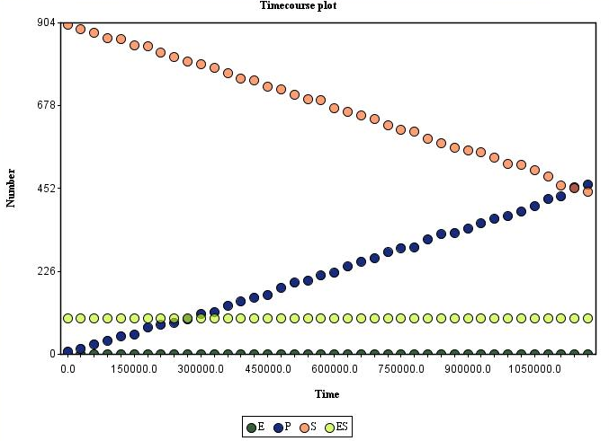
Analysis of Data
Notes:
Throughout this simulation, the algorithm is periodically recording the values for each species such that the output of the simulation is a time trace of each species count at discrete time points. From this data, there are many analyses one might do. Here we plot the count of each species over the progression of this one trace. We can see from this that ES complex quickly achieves a stead state value as assumed by Michaelis-Menton derivations. In practice, the Gillespie algorithm is very time consuming to run. The algorithm is as true to reality as we believe it to be, but if you have many molecules in the system, it becomes impractical to run at this level of detail. Approximations such as Tau-leaping amongst others have been devised to approximate Gillespie while obtaining more realistic run times.

Slide 19
Stochastic models of translation
Notes:
We’ve seen in previous chapters how challenging it can be to accurately model the process of translation and predict expression levels in the cell. One additional complexity for modeling these processes is the stochastic nature of translational elongation.

Slide 20
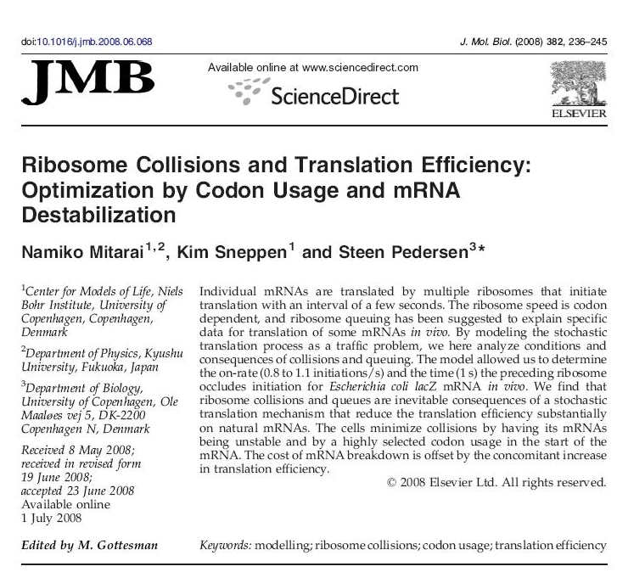
PMID 15790856
Notes:
In this paper by Pedersen and coworkers, they use a stochastic model to describe translation elongation. They model individual ribosomes performing each elemental amino acid extension reaction, and at this granularity they are able to simulate collisions and bottlenecks. Just like cars going down a crowded highway, some sequences are more prone to blockages than others, and protein production is not necessarily linearly with respect to translation initiation.

Slide 21
The noise problem
Extrinsic noise originates from fluctuations in cellular components such as metabolites, ribosomes, and polymerases and has a global effect on a per cell (but it will average out over a population)
Intrinsic noise results from stochasticity in the biochemical reactions at an individual gene and would cause identical copies of a gene to express at different levels
Both translation and transcription have been shown to be sensitive to intrinsic and extrinsic noise
This paper uses modeling and experiment to describe the issue of traffic on an mRNA and how it is coupled to individual rates of translation initiation
This is an example of intrinsic noise
Notes:
The phenomena being captured in their model is an example of biomolecular noise, and more specifically intrinsic noise. In bio, there are two kinds of noise:
*
Extrinsic noise originates from fluctuations in cellular components such as metabolites, ribosomes, and polymerases. These changes in concentration have a global effect on a per cell basis, but it will average out over a large population of cells.
Intrinsic noise results from stochasticity in the biochemical reactions at an individual gene and would cause identical copies of a gene to express at different levels
*
Both translation and transcription are known to be sensitive to intrinsic and extrinsic noise.
*
This paper uses modeling and experiment to describe the issue of traffic on an mRNA and how it is coupled to individual rates of translation elongation. It deals with the issues associated with adjacent slow and fast codons.
*
Random collisions is an example of intrinsic noise because they effect the ultimate expression level of a single gene

Slide 22
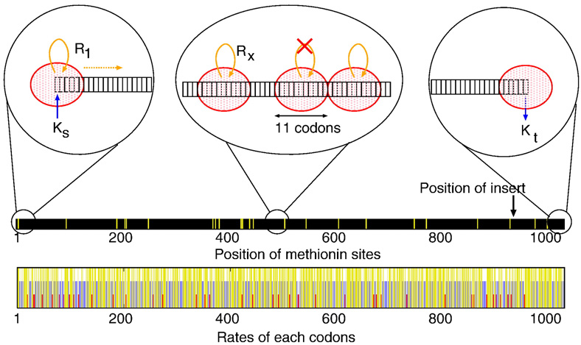
The model
Translation starts by binding a 30S ribosomal subunit to codon 1 with the rate Ks, provided that the binding site is not occluded by another ribosome within an occluding distance d
The ribosome stays at codon 1 for a time, τ, to assemble the translating 70S ribosome
After τ, all ribosomes have a probability Rxdt to move one codon forward (Rx is the translation rate for the codon at position x chosen from a table of rates for each codon)
Movements are accepted only if the distance to the preceding ribosome is larger than d
When the ribosome reaches the end of the mRNA the peptide is released with a rate Kt
Notes:
The stochastic model describes translation as distinct initiation, elongation, and termination phases. In each phase, the large footprint of the ribosome bound to the mRNA is taken into account. If a ribosome is already at a certain position of the sequence, then another ribosome is not allowed to exist there as well.
Translation starts by binding a 30S ribosomal subunit to codon 1 with the rate Ks, provided that the binding site is not occluded by another ribosome within an occluding distance d
The ribosome stays at codon 1 for a time, τ, to assemble the translating 70S ribosome
After τ, all ribosomes have a probability Rxdt to move one codon forward (Rx is the translation rate for the codon at position x chosen from a table of rates for each codon)
Movements are accepted only if the distance to the preceding ribosome is larger than d
When the ribosome reaches the end of the mRNA the peptide is released with a rate Kt

Slide 23
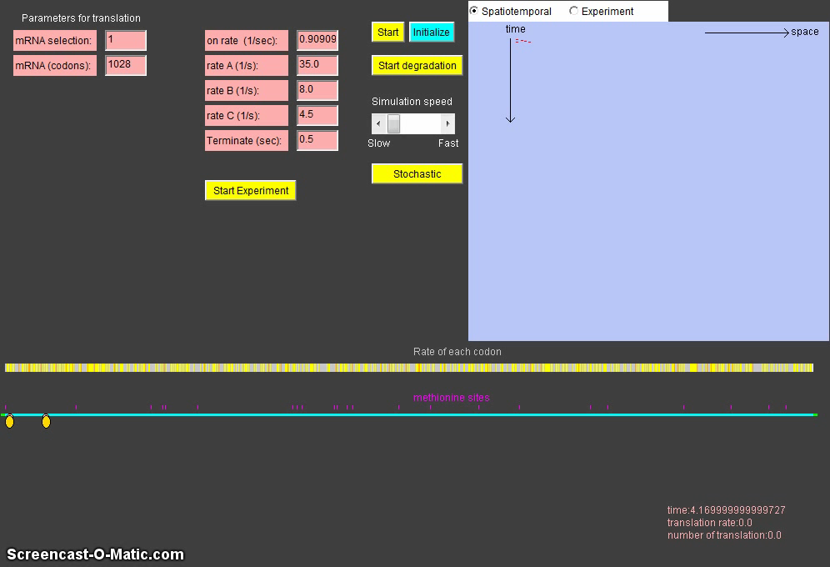
Video of the simulation
http://cmol.nbi.dk/models/RibosomeTraffic/RibosomeTraffic.html.
Notes:
You can play with this simulation online at the shown URL. The interesting variables to play with are the on rate and whether it allows the mRNA to be degraded or not, which is this ‘start degradation’ button.
*
As you start the simulation, you see ribosomes entering the mRNA, and you can see how that their movements are jostled as they move across due to crowding effects.

Slide 24
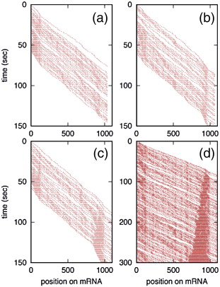
Examples of bottlenecks
Notes:
Here’s an example of what happens on certain sequences. In these diagrams, each red dot represents a ribosome at some position on the mRNA. At low levels of translation initiation such as in (a), the ribosomes do not accumulate anywhere on the sequence because there is no crowding. However, as the initiation rate increases, the crowding effect gets more exacerbated and we see a heavy accumulation of the ribosomes around 800 nucleotides into the mRNA. The result of this would be a nonlinearity in the elongation rate, where the expression for beta of translation is no longer linearly related to translation initiation rates.

Slide 25
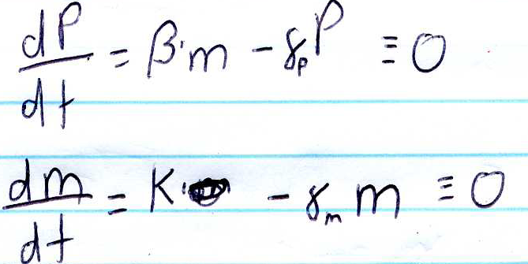
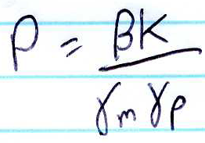
Why slow codons at start of ORFs?
The occlusion time will respond to changes in substrate level if the rare codons, for instance, GAG, are unsaturated whereas the fast translated codon GAA is saturated (GAA and GAG are read by the same tRNA but are translated with A and B rates, respectively). This allows negative feedback to fine-tune the initiation rate.
Slowly translated codons in the beginning of the mRNA will increase the average ribosome distance in the later part of the gene and thereby minimize queues there.
So, the location of slower and faster codons in an ORF could influence overall translation rate, but also could increase or decrease the distribution of rates observed within a cell
Also, having higher transcription rates combined with lower translation rates might give less variation
Notes:
The biggest claim of the model is an explanation for why there are slow codons at the start of ORFs, which can be seen statistically for natural sequences.
The occlusion time will respond to changes in substrate level if the rare codons, for instance, GAG, are unsaturated whereas the fast translated codon GAA is saturated (GAA and GAG are read by the same tRNA but are translated with A and B rates, respectively). This allows negative feedback to fine-tune the initiation rate.
Slowly translated codons in the beginning of the mRNA will increase the average ribosome distance in the later part of the gene and thereby minimize queues there.
So, the location of slower and faster codons in an ORF could influence overall translation rate, but also could increase or decrease the distribution of rates observed within a cell
Also, having higher transcription rates combined with lower translation rates might give less variation
For example, looking back at our Shea-Ackers modeling of gene expression, the same steady state concentration of P can be reached by adjusting the translation rate beta or the transcription rate K. Thus, we could use a stronger promoter and have a higher K while lowering beta for slower translation and still achieve the same amount of protein product.

Slide 26

Stochastic Modeling
in Java

Slide 27
Install Netbeans
For PC users, download the netbeans bundle at: http://www.oracle.com/technetwork/java/javase/downloads/jdk-netbeans-jsp-142931.html For Mac users, go to: http://netbeans.org/downloads/ Select your platform, and then download the "java" version of the tool.
Install netbeans, and then confirm it launches.

Slide 28
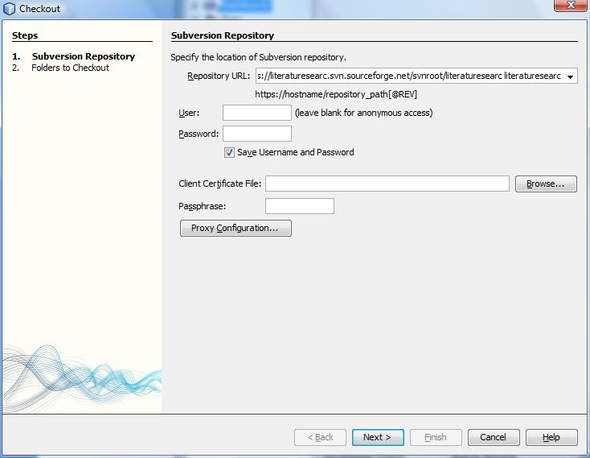
Checkout the code using subversion
Open netbeans, navigate the menus to:
Team > Subversion > Checkout
The URL is
http://svn.code.sf.net/p/andersonlab/code/
Then click “Next”
Put URL here then click Next

Slide 29
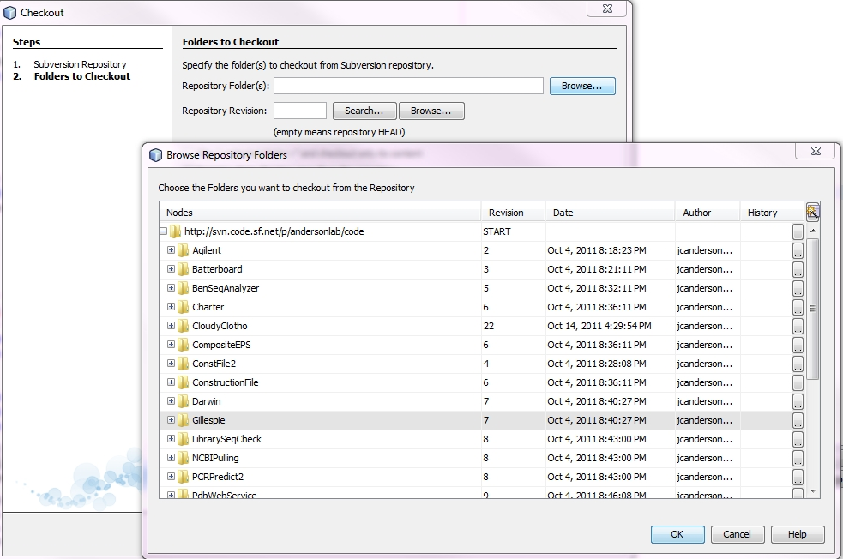
Checkout the code using subversion
In the next window, click browse, click Gillespie, then click OK.

Slide 30
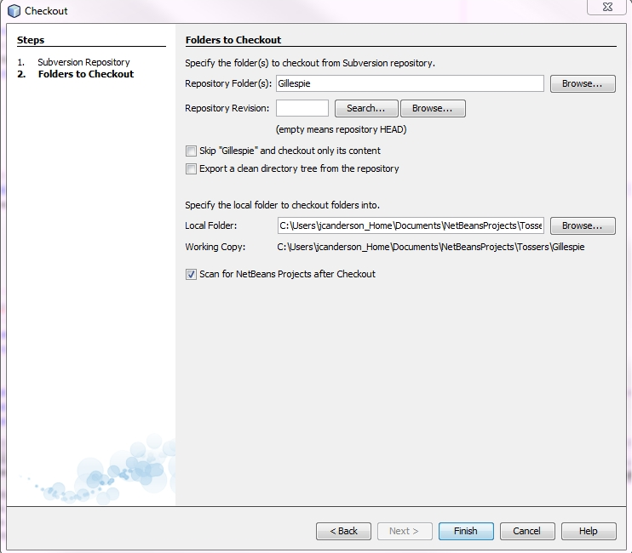
Checkout the code using subversion
Where it says “Local Folder” put in the file path to where you want to store your source code. YOU WILL BREAK THINGS IF YOU TRY TO MOVE THE FILES LATER. Then click “Finish”
Choose where to store the code here

Slide 31
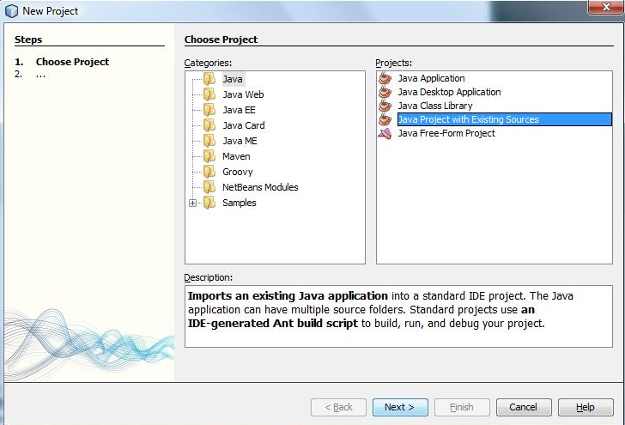
Create new project
Go under File > New Project
In the Window, select Java on the left and Java Project with Existing Sources on the right. Click Next.

Slide 32
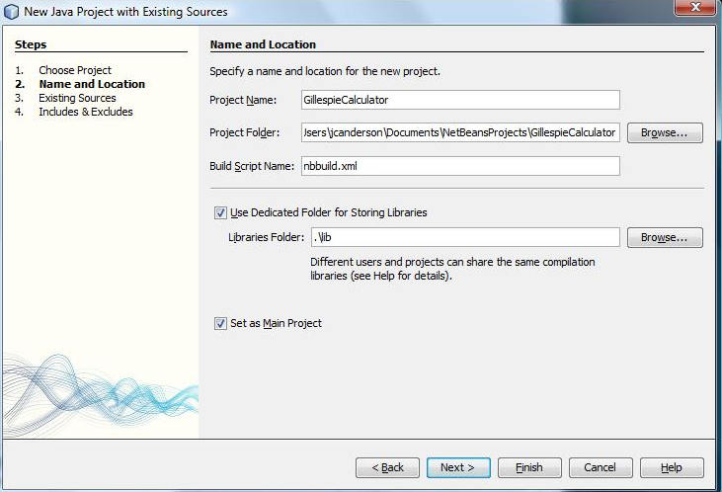
Create new project
Give it a name such as GillespieSimulator (it can be anything) and choose a place to store the Project. It is usually a different place than where you store the source code. Click Next.

Slide 33
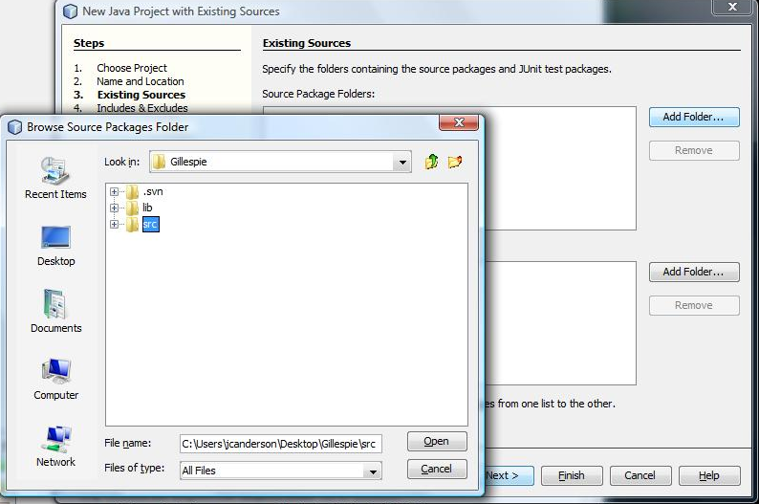
Create new project
Now, point the new project to the sourcecode you downloaded. Click Add Folder, navigate to the Gillespie Folder, open it, highlight src then click open. Then click Finish.

Slide 34
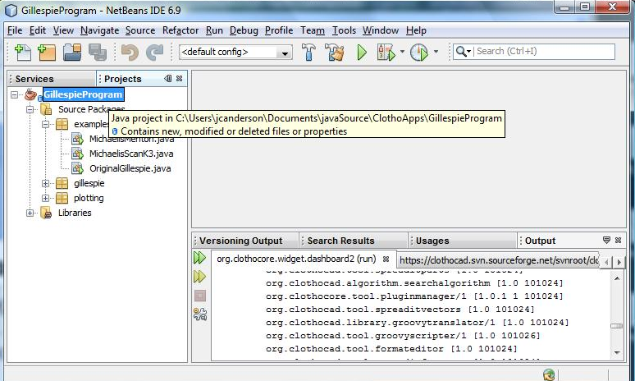
Add the Chart library
One last thing to do… you need to add a library to make charts. From the Projects panel, right click on the root node for your new project, then select Properties.
Right click here

Slide 35
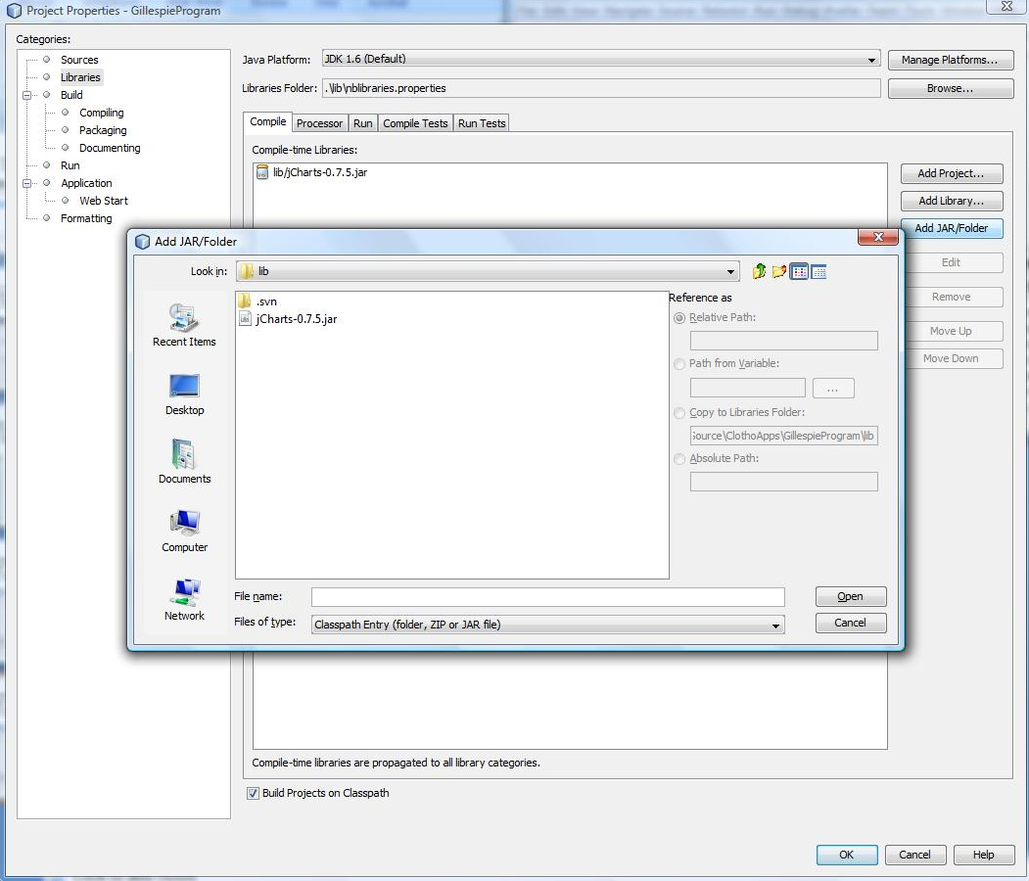
Add the Chart library
Click Libraries, then Add JAR/Folder, then navigate to the Gillespie/lib folder and select Jcharts-8.7.5.jar, and click open. Click OK to close properties.
1) Click here
2) Click here
3) Navigate to and select that
4) Click that

Slide 36
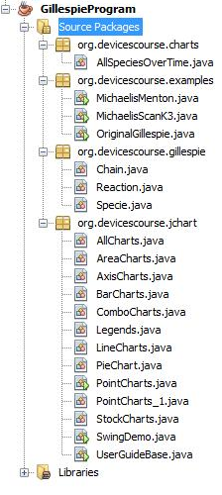
All done!
OK! That’s it for getting the project created. It’s ready for running and modifying.
Right click here
If later I ask you to update your code, right click on the Source Packages node, navigate to Subversion, then click Update.

Slide 37
What’s in the code?
A project is composed of multiple packages. A package contains multiple .java files. One .java file has one or more Classes.
Package charts: Classes for creating various types of charts
Package examples: Contains classes with main methods that can be directly run. You’ll mostly add more classes here.
Package gillespie: Core code for running the simulation. You’re unlikely to change this code.
Package jchart: This mess is the code for bridging the easy-to-use code in the charts package to the jchart library. You’re unlikely to ever want to look at it.

Slide 38
What’s in the code?
The .java files encode Classes. Classes encode Objects sortov like DNA encodes ORFs which encode proteins
Double click on MichaelisMenton.java to open its code
Any of these examples can be directly run. Right click on the class’s name then choose Run File.

Slide 39
Java Basics
For an excellent training document on Java core principals and syntax, check out http://math.hws.edu/javanotes/

Slide 40
What’s in a Class?
Like all C-based languages, blocks of code are enclosed within brackets. Statements end in semicolons.
The business portion of the class is the class declaration and the code contained within it.
Anthing outside of those brackets isn’t really in the class.
Outside the Class, you’ll see there are comments (not compiled), import statements and a package declaration. The package declaration is just how you encode…well, where it is. The import statements are the longer addresses of Classes outside this package referred to by the code.
/**Comments
*
*/
public class MichaelisMenton {
}

Slide 41
The Constructor
Classes can have one or more constructors. When a class is instantiated, one of the constructors is run. You can locate the constructors because
Their name is the same as the Class
They have no return values
public class MichaelisMenton {
public MichaelisMenton(…) {
…
}
}
There may be arguments in here
Name same as Class
Return value would be there, you know it’s a constructor because there’s nothing there.

Slide 42
Methods and class variables
Methods are java-speak for what in other C-based languages are called subroutines. The syntax is the same as other C-based languages with the addition of “modifier” words like public, private, protected, static, final, abstract (and a few more).
Variables declared outside of Methods are “class variables” and are accessible from any instance method within the code of the class.
You can also have variables that are local to a method or to a loop or if statement.
public class MichaelisMenton {
public MichaelisMenton(…) {
…
}
public String getName(int i) {
return _name;
}
private String _name;
}

Slide 43
Methods and class variables
Another way of explaining what’s going on here is as follows…
If I have a MichaelisMenton object, let’s call it michmen. It currently holds the value “Bob” in it’s field “_name”. If call:
String str = michmen.getName(24)
That will invoke the getName(…) method and pass it the value 24. The method will return the value of the variable _name, which is “Bob,” so now the String called str now has the value “Bob”.
public class MichaelisMenton {
public MichaelisMenton(…) {
…
}
public String getName(int i) {
return _name;
}
private String _name;
}

Slide 44
Instance versus Static
OK, this is the Object thing. Anything with the “static” modifier is … static. It exists only once in all objects instantiated from the Class. Everything else is, in effect, duplicated as a unique copy for each instantiatiation. Those methods/variables belong to the instance, not to all members of the Class.
public class MichaelisMenton {
public MichaelisMenton(…) {
…
}
public String getName(int i) {
return _name;
}
public class MichaelisMenton {
public MichaelisMenton(…) {
…
}
public static int getInt() {
return _five;
}
public class MichaelisMenton {
public MichaelisMenton(…) {
…
}
public class MichaelisMenton {
public MichaelisMenton(…) {
…
}
public String getName(int i) {
return _name;
}
public class MichaelisMenton {
public MichaelisMenton(…) {
…
}
private String _name;
}
public String getName(int i) {
return _name;
}
private static int _five = 5;
public String getName(int i) {
return _name;
}
private String _name;
}
public String getName(int i) {
return _name;
}
Class
private String _name;
}
Instances
private String _name;
}
private String _name;
}

Slide 45
Running it
Usually, multiple classes constitute a Java program. At least one of them needs to have a “main” method.
This is what actually gets called when you say “Run File”.
There can be only one main method in each class, but you can have main methods in multiple classes. When you choose “Run File” you are running the main method for that Class.
One Class can be set as the “main Class ” and it’s main method will be called when you run the entire project.
public class MichaelisMenton {
public MichaelisMenton(…) {
…
}
public static void main(String[] args) {
//run the thing
}
}

Slide 46
Gillespie Algorithm
Original Gillespie paper is on Bspace under Resources/Papers/Gillespie_algorithm.pdf

Slide 47
The basic idea
There is a time series of events happening within a cell. Each event corresponds to some Reaction that occurred
cell1
Time
An Enzyme and a substrate formed a complex
An ES Complex made a product
An ES Complex dissociated

Slide 48
The basic idea
Different random events are occurring within different cells
cell1
cell2
cell3
Time

Slide 49
The Algorithm
“First-reaction” Method
Choose a random Reaction to do next, but choose it based on the probability that it will occur, and that’s related to the mass-action kinetics rate of the reaction
Choose the random time interval at which this next reaction will occur
Update the time and number of molecules for each Specie that participated in the Reaction
Keep iterating this until some end time is reached

Slide 50
Java implementation of Gillespie
The original implementation (in the paper) is in Fortran
You can directly translate that into Java, but you’ll find it helpful to take advantage of a more object-oriented reinterpretation
The Gillespie algorithm has been split into 3 Classes
Chain - This is the class that represents the events happening in one cell. It is the simulated unit of the algorithm. It’s what you call “run” on. One instance of a Chain corresponds to one trajectory through one cell’s life history from time zero to the end time
Specie - Species belong to a Chain. It corresponds to the population of one equivalent biochemical species within the one cell. The Specie holds the history of events that happened to that population.
Reaction - Something that can happen as an event within the Chain. Reactions refer to specific Species. They have 2 methods: one to calculate the current rate, one to update the concentrations of the affected species.

Slide 51
How to set up a stochastic simulation
Write out chemical reactions describing the system in its most granular form
For reversible reactions, the forward and reverse reactions are two distinct Reactions
E
+
S
ES
ES
E
+
S
ES
E
+
P

Slide 52
Identify all the Species
E
+
S
ES
ES
E
+
S
ES
E
+
P
In this case there are 4 Species

Slide 53
Coding it
Create a Chain object. The argument passed to the constructor is the end time:
Chain chain = new Chain(1200000);
Create Specie objects. The argument passed to the constructor is the Chain, its initial number of molecules, and a name
final Specie Enzyme = new Specie(chain, 100, "E");
final Specie ESComplex = new Specie(chain, 0, "ES");
final Specie Substrate = new Specie(chain, 1000, "S");
final Specie Product = new Specie(chain, 0, "P");

Slide 54
Coding it
Create a Reaction Array. Basically, you’re creating a list of Reactions. Here you are telling it that 3 reactions are coming.
Reaction[] reactions = new Reaction[3];

Slide 55
Coding it
Create individual Reactions. You need to tell it how to change the species and how to calculate the probabililty that the reaction will occur
//For E + S --> ES
reactions[0] = new Reaction() {
@Override
public void updateValues() {
Enzyme.decrement();
Substrate.decrement();
ESComplex.increment();
}
@Override
public double calculateQuantities() {
return K1 * Enzyme.getValue() * Substrate.getValue();
}
};

Slide 56
Coding it
Add the Reactions to the Chain, then run the Chain
chain.setReactions(reactions);
chain.start();
After this, the Species in the Chain will store what happened, and there are various ways of getting that data out
If you want all the data in a nice table in which its been consolidated into a fixed number of time bins (here it’s 40 time points) call:
Object[][] allspeciesdata = chain.getBinnedData(40);

Slide 57
Coding it
You can also directly retrieve a Specie by name and then access its data. Here, we get the Product Specie and just ask what the value was when it finished:
Specie product = MM.chain.getSpecie("P");
Double values = product.getValue();
You could also get out an array of data in the form of time, value
Specie product = MM.chain.getSpecie("P");
Double values = product.getBinnedData(40);

Slide 58
The Toggle Switch
Here’s we’ll do an example: the Collin’s lab Toggle Switch described in:
Construction of a genetic toggle switch in Escherichia coli.
Gardner TS, Cantor CR, Collins JJ.
Nature. 2000 Jan 20;403(6767):339-42.
PMID: 10659857

Slide 59
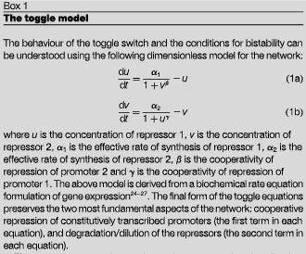
Toggle Switch with Diff. Eq.

Slide 60
Model: single-copy toggle switch
G
gfp
R
S
s
r

Slide 61
Examine each “Feature” for
Independent reactions
S
gfp
gfp
G
G
gfp
Degrades

Slide 62
Examine each “Feature” for
Independent reactions
R
s
s
S
S
S
Degrades

Slide 63
Examine each “Feature” for
Independent reactions
S
r
r
R
R
r
Degrades

Slide 64
List those reactions
P_S-GFP + S --> S.P_S-GFP K1
S.P_S-GFP --> P_S-GFP + S Kminus1
P_S-GFP --> P_S-GFP + G K2
G --> null K3
P_S-R + S --> S.P_S-R K4
S.P_S-R --> P_S-R + S Kminus4
P_S-R --> P_S-R + R K5
R --> null K6
P_R-S + R --> R.P_R-S K7
R.P_R-S --> P_R-S + R Kminus7
P_R-S --> P_R-S + S K8
S --> null K9

Slide 65
List the species
G
P_R-S
P_S-GFP
P_S-R
R
R.P_R-S
S
S.P_S-GFP
S.P_S-R

Slide 66
Code it up!
To see the implementation of this, open up “Toggle1.java” or run it
The other Toggle#.java files each encode variations on Toggle1 that do simplifications to the program or bin the data differently at the end when generating the plots.
To create your own program, copy and paste one of the existing files and then edit its contents.

